Slide 1

Summarizing Source Code with Transferred API Knowledge
Xing Hu¹ , Ge Li¹, Xin Xia², David Lo³, Shuai Lu, Zhi Jin¹
¹ Key Laboratory of High Confidence Software Technologies (PKU), China
² Faculty of Information Technology, Monash University, Australia
³ School of Information Systems, Singapore Management University, Singapore
IJCAI 2018
Notes:
Hi everyone, I am Xing Hu from PKU. I am very happy to be here to talk about our work Summarizing Source Code with Transferred API Knowledge. Our work aims to generate code summaries from source code automatically.

Slide 2
Why Code Summarization?
Code Comprehension
Comments are often missed, mismatch, outdated, …
Summarization
Aims to obtain a reductive transformation from a source text to a summary text through different techniques.
In software development and maintenance, developers spend around 59% of their time on program comprehension activities^{[1]}
[1]Xia X, Bao L, Lo D, et al. Measuring program comprehension: A large-scale field study with professionals[J]. IEEE Transactions on Software Engineering, 2017.
Notes:
In software development and maintenance, developers spend about 60% of their time on program comprehension activities. Comments are very helpful when programmers want to understand the source code. However, these comments are often missed, mismatch and outdated during the development. Therefore, many techniques are proposed to generate code summaries automatically.

Slide 3
Existing Approaches
Information Retrieval Approaches
Extract natural descriptions from software artifacts, e.g., bug report, Stack Overflow…
Extract keywords from source code
Limitations:
Heavily rely on whether similar code snippets can be retrieved and how similar the snippets are.
Fail to extract accurate keywords when identifiers and methods are poorly named.
Notes:
Existing approaches usually use information retrieval approaches to extract natural descriptions or keywords from open source code.
These approaches have some limits:

Slide 4
Existing Approaches
Deep Learning based Approaches
CODE-NN^{[2]}
DeepCom^{[3]}
Limitations:
Simply treat the code summarization task as machine translation task
Ignore some latent knowledge in the source code
[2] Iyer S, Konstas I, Cheung A, et al. Summarizing Source Code using a Neural Attention Model. ACL. 2016.
[3] Xing Hu, Ge Li, Xin Xia, et al. Deep code comment generation. ICPC.2018
Notes:
Recently, some deep learning based approaches have been exploited to the code summarization task. These works usually build probabilistic models of source code.
Although deep learning techniques are successful in the first step toward automatic summary generation, the performance is limited since they treat source code as plain text and ignore some latent knowledge in the source code.

Slide 5
API Knowledge in Source Code
Developers often invoke a specific API sequence to implement a function.
“Parse XML files”
“open a url”
DocumentBuilderFactory.newInstance
↓
DocumentBuilderFactory.newDocumentBuilder
↓
DocumentBuilder.parse
URL.new
↓
URL.openConnection
Notes:
One of the most relevant knowledge between source code and summaries is API knowledge. Developers often invoke a specific API sequence to implement a function. For example, if developers what to open a url, firstly, they have to create an object of url, and then invoke the url connection methods. This latent knowledge can assist the generation of code summaries. The goal of our work is to better use this knowledge to assist code summarization.

Slide 6
API Knowledge in Source Code
Developers often invoke a specific API sequence to implement a function.
“Parse XML files”
“open a url”
DocumentBuilderFactory.newInstance
↓
DocumentBuilderFactory.newDocumentBuilder
↓
DocumentBuilder.parse
URL.new
↓
URL.openConnection
The latent knowledge in API sequence can assist the generation of code summaries.
Notes:
One of the most relevant knowledge between source code and summaries is API knowledge. Developers often invoke a specific API sequence to implement a function. For example, if developers what to open a url, firstly, they have to create an object of url, and then invoke the url connection methods. This latent knowledge can assist the generation of code summaries. The goal of our work is to better use this knowledge to assist code summarization.

Slide 7
To Better Use of API Knowledge
?
Code
Summarization
Task
Learning System
Learning System
API Knowledge
Notes:
To better use of API knowledge, we learn from the idea of transfer learning. In this work, we utilize API knowledge learned from a task to assist a different but related task, that is

Slide 8
To Better Use of API Knowledge
API Sequence
Summarization
Task
Code
Summarization
Task
Learning System
Learning System
API Knowledge
Notes:
In this paper, we use API sequence summarization task to learn the API knowledge.

Slide 9


TL-CodeSum: Workflow
Summary generation phase
public static void sort(Comparable[] a){
int n=a.length;
for (int i=1; i < n; i++){
Comparable v=a[i];
int lo=0, hi=i;
while (lo < hi) { ... }
...
}
assert isSorted(a);
}
Sorts the array in ascending order,using the natural order.
Code Tokens
Summary
Tokens
Java method
without comment
API Sequence
Code
Summary
Training phase
API Sequence Summarization Model
Code Summarization Model
Code Encoder
(Code Tokens)
API Encoder
(API Sequence)
API Encoder
(API Sequence)
09~14
Summary Decoder
(Tokens)
15~16
Summary Decoder
(Tokens)
Notes:
Inspired by the transfer learning, this is an overview of our work. First，we obtain a parallel dataset of API sequence and corresponding natural language descriptions. Then, we use the API summarization model to learn the API knowledge. When it comes to code summarization task, we obtain another dataset, which is a set of API sequence, code tokens and summary. We train a code summarization model with API knowledge based on the dataset. In the last, we evaluate the test results on the trained model.

Slide 10
API Summarization Task
API sequence summarization aims to build the mappings between API knowledge and natural language descriptions.
DataOutputStream.writeByte —>
DataOutputStream.writeShort—>
DataOutputStream.writeShort
“Write the constant to the output stream”
Notes:
First of all, I will introduce the API summarization task. API …. We use a basic attention based sequence to sequence model to generate summaries for API seuqneces. The encoder embeds API sequence and the decoder generates natural language descriptions with API vectors. The API knowledge is the learned API sequence encoder and the API embeddings.

Slide 11
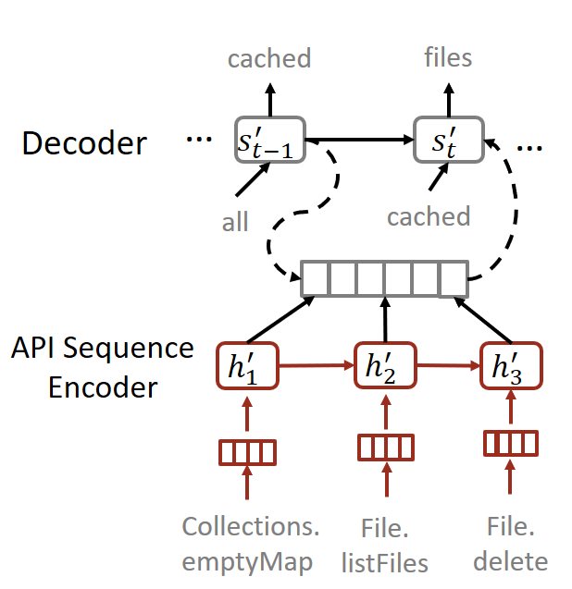
API Summarization Task
API sequence summarization aims to build the mappings between API knowledge and natural language descriptions.
DataOutputStream.writeByte —>
DataOutputStream.writeShort—>
DataOutputStream.writeShort
“Write the constant to the output stream”
Attention based Seq2Seq
Encoder: embeds API sequence
Decoder: generates NL descriptions with API vectors
Notes:
First of all, I will introduce the API summarization task. API …. We use a basic attention based sequence to sequence model to generate summaries for API seuqneces. The encoder embeds API sequence and the decoder generates natural language descriptions with API vectors. The API knowledge is the learned API sequence encoder and the API embeddings.

Slide 12
API Summarization Task
API sequence summarization aims to build the mappings between API knowledge and natural language descriptions.
DataOutputStream.writeByte —>
DataOutputStream.writeShort—>
DataOutputStream.writeShort
“Write the constant to the output stream”
Attention based Seq2Seq
Encoder: embeds API sequence
Decoder: generates NL descriptions with API vectors
API Knowledge
Notes:
First of all, I will introduce the API summarization task. API …. We use a basic attention based sequence to sequence model to generate summaries for API seuqneces. The encoder embeds API sequence and the decoder generates natural language descriptions with API vectors. The API knowledge is the learned API sequence encoder and the API embeddings.

Slide 13
Code Summarization Task
void write(Environment env,
DataOutputStream out,
ConstantPool tab) throw IOException{
out.writeByte(CONSTANT_NAMEANDTYPE);
out.writeShort(tab.index(name));
out.writeShort(tab.index(type));
}
“Write the constant to the output stream”
Notes:
Previous works usually use a seq2seq model to generate code summaries from source code directly. However, in this paper, we use a variant seq2seq model to generate summaries from code tokens and API knowledge. The model adds an extra API encoder. The API encoder encodes the API sequence which is contained in the source code. In order to use the learned API knowledge, the API sequence encoder and API embeddings are transferred from API sequence summarization task.

Slide 14
Code Summarization Task
void write(Environment env,
DataOutputStream out,
ConstantPool tab) throw IOException{
out.writeByte(CONSTANT_NAMEANDTYPE);
out.writeShort(tab.index(name));
out.writeShort(tab.index(type));
}
“Write the constant to the output stream”
Notes:
Previous works usually use a seq2seq model to generate code summaries from source code directly. However, in this paper, we use a variant seq2seq model to generate summaries from code tokens and API knowledge. The model adds an extra API encoder. The API encoder encodes the API sequence which is contained in the source code. In order to use the learned API knowledge, the API sequence encoder and API embeddings are transferred from API sequence summarization task.

Slide 15
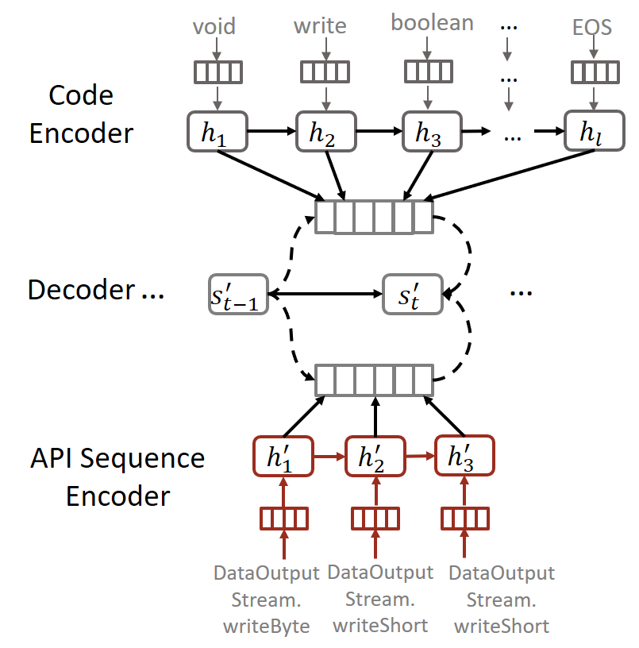
Code Summarization Task
void write(Environment env,
DataOutputStream out,
ConstantPool tab) throw IOException{
out.writeByte(CONSTANT_NAMEANDTYPE);
out.writeShort(tab.index(name));
out.writeShort(tab.index(type));
}
“Write the constant to the output stream”
Notes:
Previous works usually use a seq2seq model to generate code summaries from source code directly. However, in this paper, we use a variant seq2seq model to generate summaries from code tokens and API knowledge. The model adds an extra API encoder. The API encoder encodes the API sequence which is contained in the source code. In order to use the learned API knowledge, the API sequence encoder and API embeddings are transferred from API sequence summarization task.

Slide 16
Code Summarization Task
void write(Environment env,
DataOutputStream out,
ConstantPool tab) throw IOException{
out.writeByte(CONSTANT_NAMEANDTYPE);
out.writeShort(tab.index(name));
out.writeShort(tab.index(type));
}
“Write the constant to the output stream”
DataOutputStream.writeByte —>
DataOutputStream.writeShort—>
DataOutputStream.writeShort
Notes:
Previous works usually use a seq2seq model to generate code summaries from source code directly. However, in this paper, we use a variant seq2seq model to generate summaries from code tokens and API knowledge. The model adds an extra API encoder. The API encoder encodes the API sequence which is contained in the source code. In order to use the learned API knowledge, the API sequence encoder and API embeddings are transferred from API sequence summarization task.

Slide 17
Code Summarization Task
void write(Environment env,
DataOutputStream out,
ConstantPool tab) throw IOException{
out.writeByte(CONSTANT_NAMEANDTYPE);
out.writeShort(tab.index(name));
out.writeShort(tab.index(type));
}
“Write the constant to the output stream”
API Knowledge
DataOutputStream.writeByte —>
DataOutputStream.writeShort—>
DataOutputStream.writeShort
Notes:
Previous works usually use a seq2seq model to generate code summaries from source code directly. However, in this paper, we use a variant seq2seq model to generate summaries from code tokens and API knowledge. The model adds an extra API encoder. The API encoder encodes the API sequence which is contained in the source code. In order to use the learned API knowledge, the API sequence encoder and API embeddings are transferred from API sequence summarization task.

Slide 18
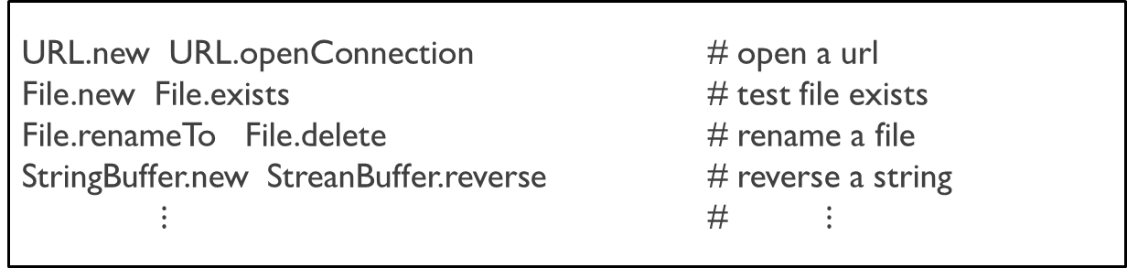
Collecting two Corpora
API Summarization Task
<API Sequence, Annotation> pairs
URL.new URL.openConnection # open a url
File.new File.exists # test file exists
File.renameTo File.delete # rename a file
StringBuffer.new StreanBuffer.reverse # reverse a string
$⋮$ # $⋮$
API Sequences (Java)
Annotations(English)
Collect 13,154 Java projects from GitHub (2008-2014)
Extract an API sequence and an annotation for each method body (when Javadoc comment exists)
340,922 pairs
Notes:
Next, I will introduce the dataset collection process. For API summarization task, we obtained the Java projects created from 08 to 14 from github. Extract an API sequence and an annotation for each method body. In the end, we had about 340000 pairs in our dataset.

Slide 19
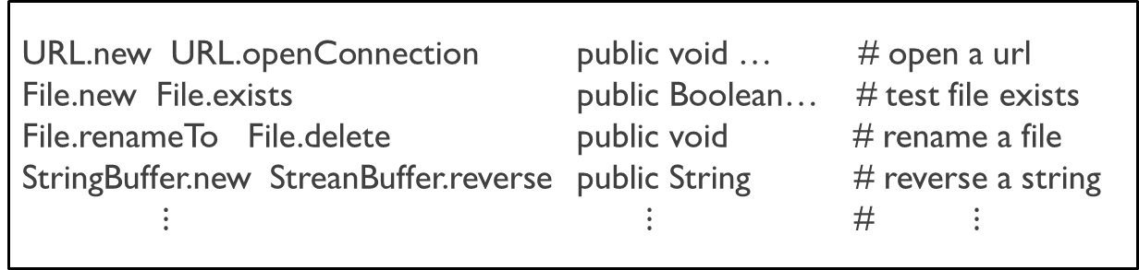
Collecting two Corpora
Code Summarization Task
<API Sequence, Code Tokens, Annotation> instances
URL.new URL.openConnection public void … # open a url
File.new File.exists public Boolean… # test file exists
File.renameTo File.delete public void # rename a file
StringBuffer.new StreanBuffer.reverse public String # reverse a string
$⋮$ $⋮$ # $⋮$
API Sequences (Java)
Tokens(Java)
Annotations(English)
Collect 9,732 Java projects from GitHub (2015-2016)
Extract an API sequence, the method tokens and an annotation for each method body (when Javadoc comment exists)
69,708 instances
Notes:
For code summarization task, we obtained the Java projects created from 15 to 16 from github. Extract an API sequence, method tokens and an annotation for each method body. We also excluded the methods which are easy to predict comments. Anyway, in the end, we had about 70000 instances for training in our dataset.

Slide 20
Experiment
Experiment Settings
GRU, 128 hidden states
128 for API, code tokens, and summary embeddings
Batch size: 32
SGD algorithm
Vocabulary size: 50,000, 33,082, and 26,971 for code, API, and summaries respectively.
Beam size: 5
Notes:
In the following part, I will introduce our experiment and the results. These are settings in our work. The encoders and decoders used in our work are GRU, which is one of popular RNNs.

Slide 21
Results-Accuracy
Baselines
CODE-NN
API-Only
Code-Only
API+Code
Metric
IR: Precision, Recall, F-Score
NMT: BLEU, METEOR
[Iyer, et al. ACL. 2016]
NMT model
Two encoders and a decoder
Approaches | Precision | Recall | F-Score | BLEU score | METEOR
CODE-NN | 26.21 | 14.71 | 18.4 | 25.3 | 6.92
API-Only | 30.72 | 21.14 | 25.05 | 26.45 | 10.71
Code-Only | 38.89 | 28.81 | 33.10 | 35.50 | 14.78
API + Code | 41.06 | 30.34 | 34.90 | 37.28 | 15.88
TL-CodeSum(fix) | 42.20 | 34.38 | 37.89 | 36.42 | 18.07
TL-CodeSum(fine-tuned) | 40.78 | 35.41 | 37.91 | 41.98 | 18.81
Notes:
We have 4 baselines, CODE-NN is proposed in ACL 2016. The other 3 baselines are used to evaluate the effectiveness of API knowledge in code summarization task. We use two types metrics, IR and NMT.
The results show that our work outperforms the state-of-the-art. And we concluded that the API knowledge is important for generating code summaries.

Slide 22
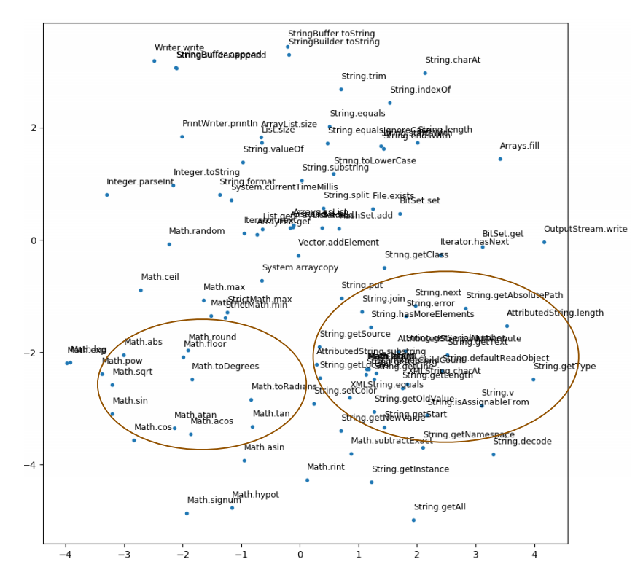
Results-API Embedding
Notes:
The quality of API embeddings is important for our proposed method to work well. For ease the demonstration, we select the APIs related to "String” and “Math” which are circled. As shown in the graph, TL-CodeSum can successfully embed APIs.

Slide 23
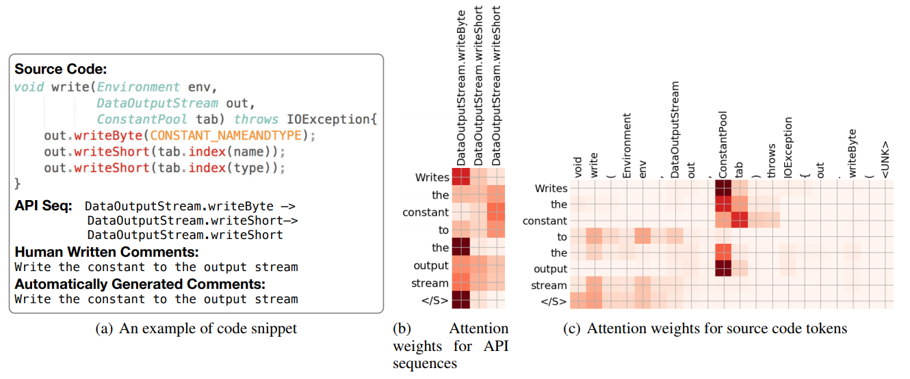
Results-Complementarity of API and Code
Attention weights for the API sequence and code tokens while generating summaries
TL-CodeSum aligns different words with specific API or code tokens.
Notes:
This figure shows the attention weights for the API sequence and code tokens within the Java method while generating its corresponding summary. From the figure, we find the words “write” and “stream” are more relevant to API “DataOutputStream.writeByte”. While the word “constant” is more relevant the variable “tab” whose type is “ConstantPool”. TLCodeSum can better align different words with specific API or code tokens.

Slide 24
Results-Examples
protected void sprint(double doubleField){
sprint(String.valueOf(doubleField));
}
API Seq: String.valueOf
Human-Written: Pretty printing accumulator function for doubles
TL-CodeSum: pretty printing accumulator function for longs
Word Replacement
Some words are replaced by their synonyms, antonyms, or words in the same domain.
public void removeMouseListener(GlobalMouseListener listener){
listeners.remove(listener);
}
API Seq: List.remove
Human-Written: Removes a global mouse listener
TL-CodeSum: removes an existing message listener
More general
The generated summaries may present more general meaning and give the abstract semantics of given Java methods.
Notes:
In addition to the automatic evaluation, we analyzed the generated summaries manually. Most generated summaries are clear, coherent, and informative related. The main differences between the generated and human-written summaries are shown these examples:

Slide 25
Results-Examples
private static boolean instanceOfAny(Object o, Collection<Class> classes){
for(Class c: classes){
if (c.isInstance(o))
return true;
}
return false;
}
API Seq: Collection.isEmpty->Collection.add->Class.isInstance
Human-Written: returns true if the Object ‘o’ is an instance of any class in the Collection
TL-CodeSum: returns true if the object is registered in classes, or false otherwise.
Missed Identifiers
Learning the identifiers is challenging. TL-CodeSum misses some identifiers or replaces them with “UNK” sometimes

Slide 26
Conclusion
Apply the API knowledge to assist the code summarization task
Learn the mappings between the API knowledge and natural language descriptions
Transfer the knowledge into a different but related task
Future Work
Apply the API knowledge into other tasks
Mining more latent knowledge in the source code
Notes:
Our work is inspired by the transfer learning, we use the API knowledge to assist the summary generation. In the future, …

Slide 27
Q&A
Thanks
Notes:
Thank you for your attention

Slide 28
Preprocessing Dataset
Summary:
/**
* read a text file line by line.
* @param: path
*/
public void readContent(String path){
…
BufferedReader reader = new BufferedReader(…);
while((line=reader.readLine())!=null)
…
reader.close();
}
read a text file line by line.
Method body tokens:
public, void, readContent……
MethodDefinition
Body
Javadoc Comment
While Statement
API Sequence:
Statement
…
Variable Declaration
Constructor Invocation
BufferedReader.new
BufferedReader.readLine
BufferedReader.close
Method Invocation
Block Statement
Type
Variable
Variable
readLine
BufferedReader
reader
reader
Gu X, Zhang H, Zhang D, et al. Deep API learning[C]//Proceedings of the 2016 24th ACM SIGSOFT International Symposium on Foundations of Software Engineering. ACM, 2016: 631-642.
Notes:
To better understand the data processing, we give an example. The extraction process is according to Gu’s work. We extract the Javadoc comments as the summaries. Then, the source code are tokenized into tokens. In order to extract the API sequence, we have to find the relationship of API invocations on the abstract syntactic trees. For example, the API invocation readline, we first find its variable reader, then find the reader’s type, that is, BufferedReader. At last, we got a entire API invocation BufferedReader.readLine.

